Slide 1

Subscribe to DeepL Pro to edit this document.
Visit www.DeepL.com/profor more information.

Slide 2
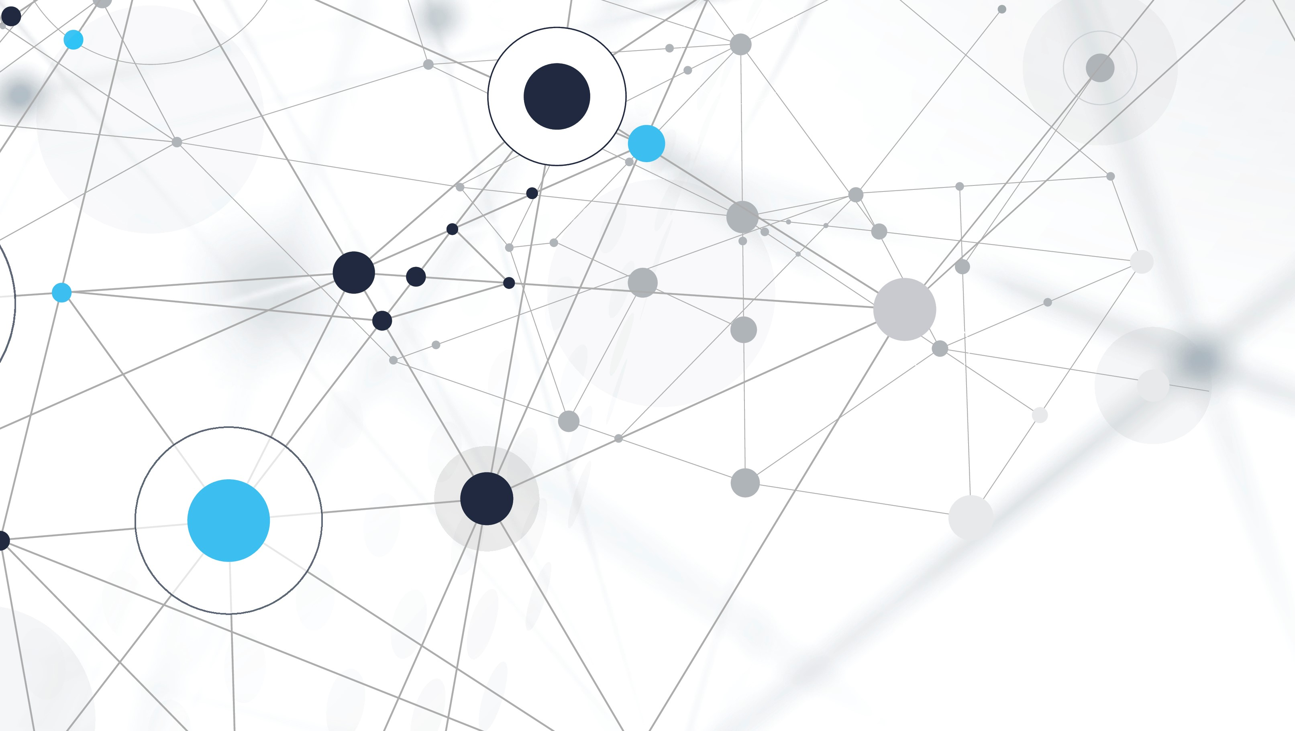

Best Move
Recognition of a chessboard and prediction of the best move.
Gallesi Pietro
Paris Luke

Slide 3
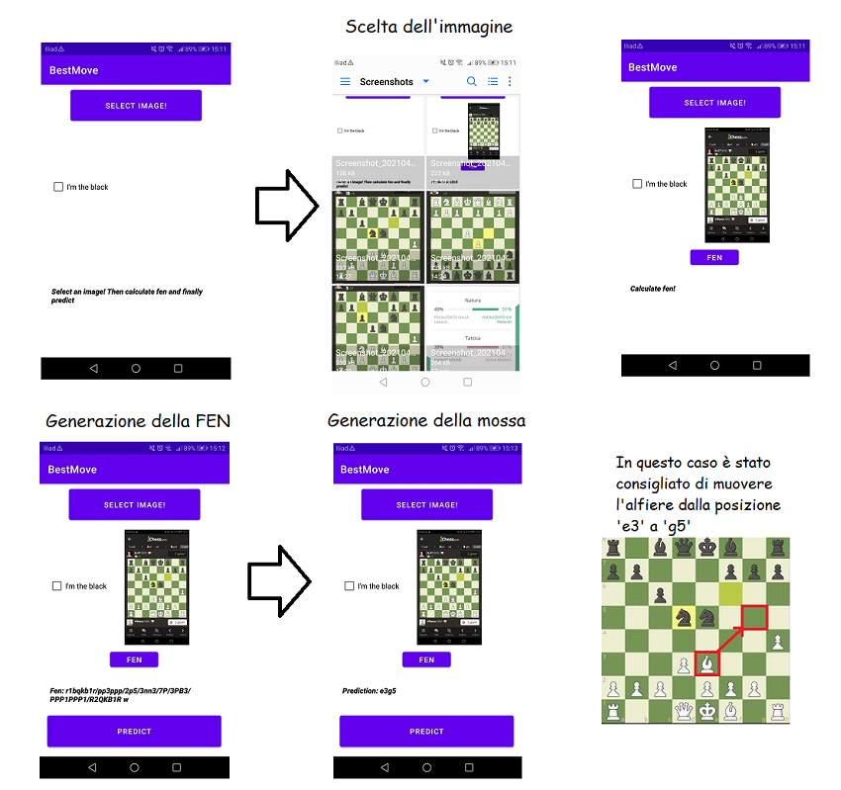
OPERATION of the application

Slide 4



Overview of tools

Slide 5
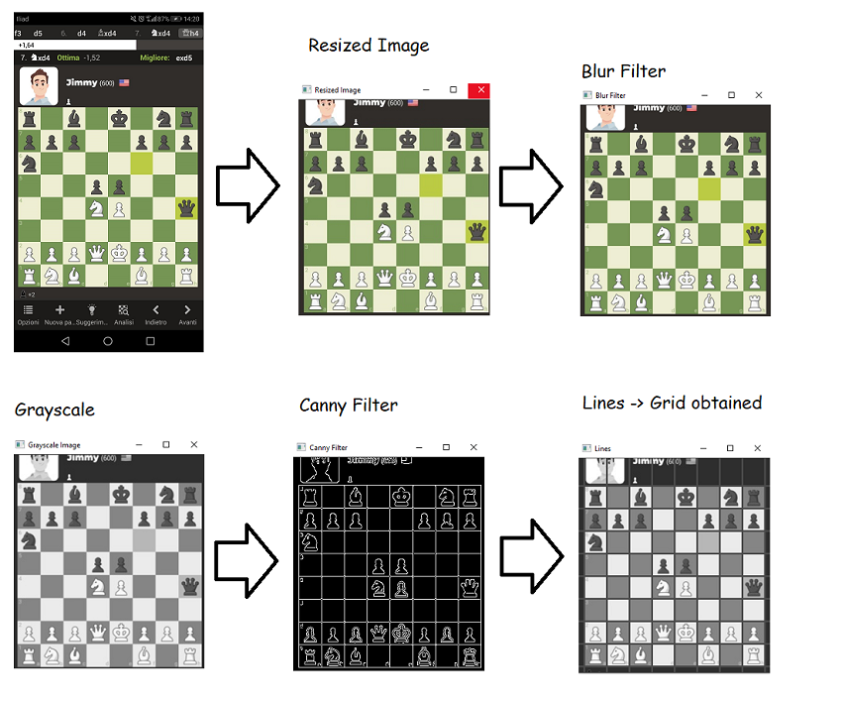
Step 1: Board Detection

Slide 6
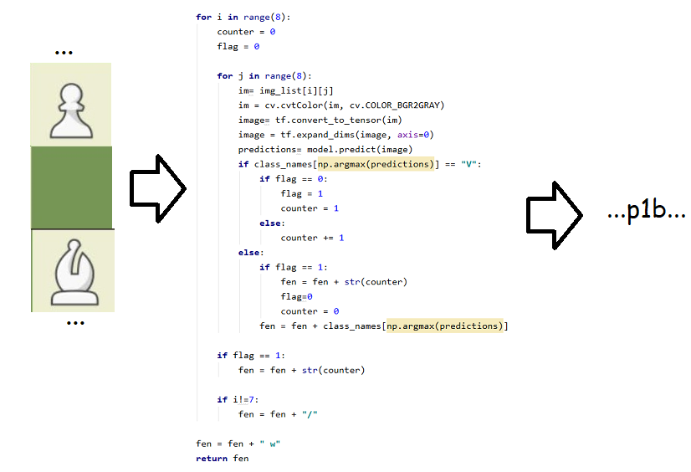
Step 2: Piece cLassificator

Slide 7
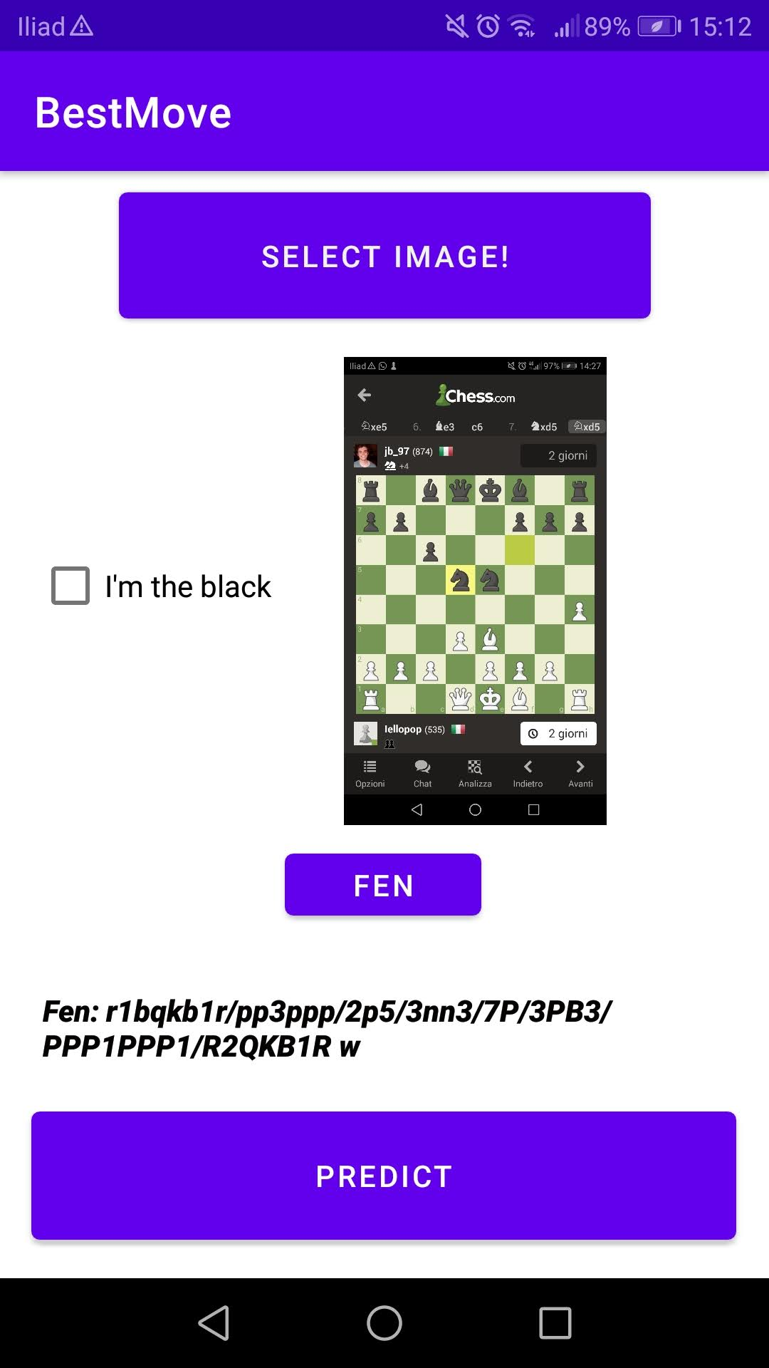
Fen

Slide 8
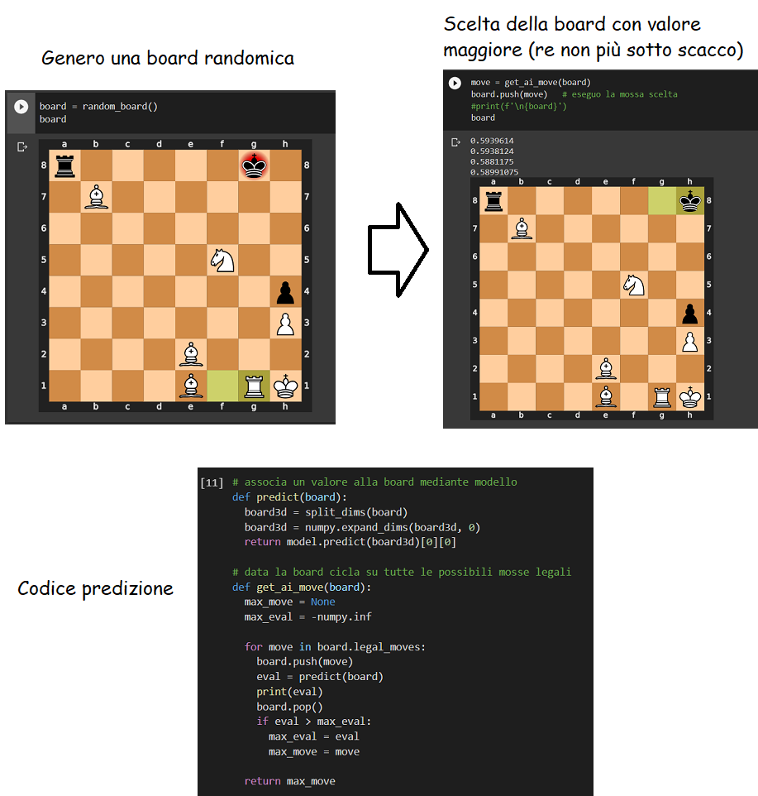
Step 3: Best move

Slide 9
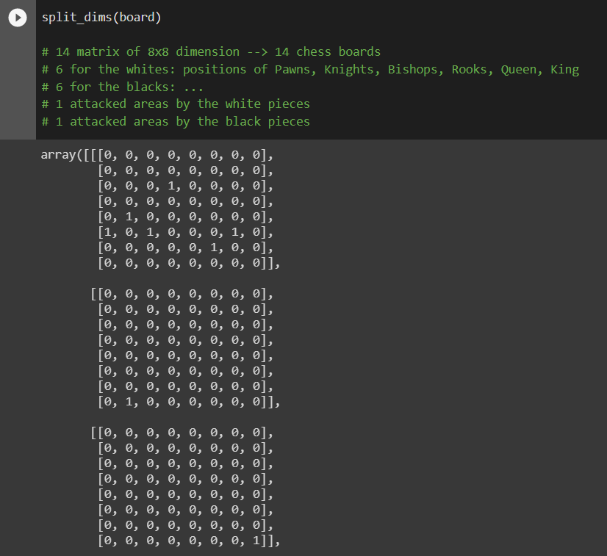
Boards represented with matrices

Slide 10
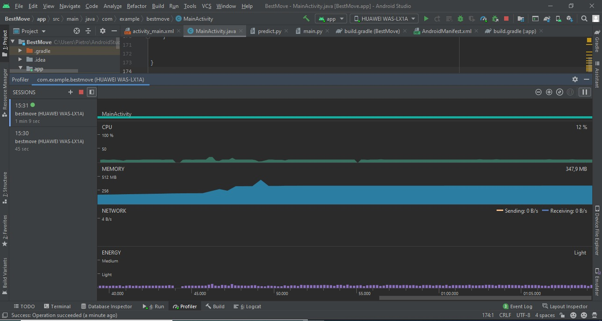
Data on mobile operation
Memory occupation: 0.98 GB
Peak CPU utilisation: 13%.
Peak memory usage: 379MB
Execution speed: between 20 and 30 seconds on Huawei P10 lite and 5 seconds on OnePlus Nord.

Slide 11
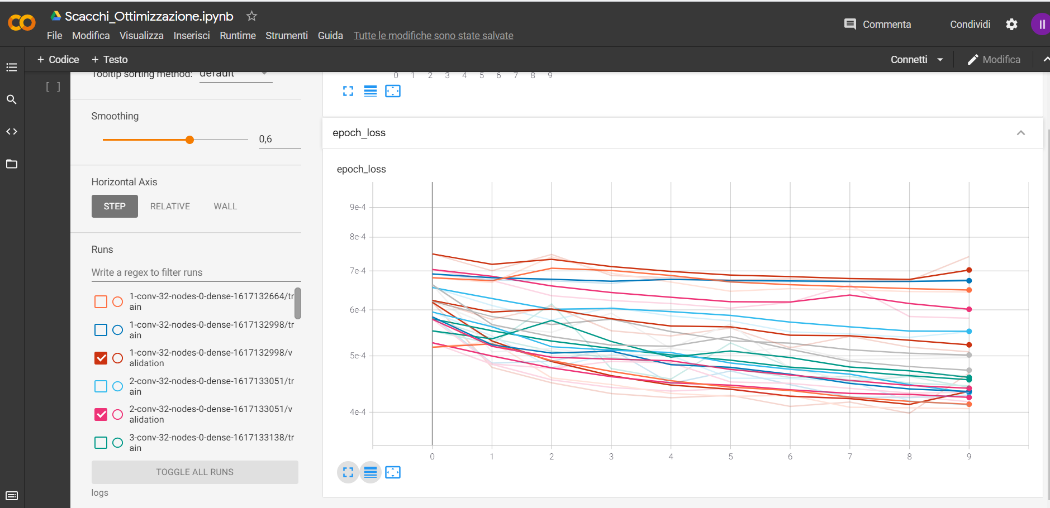

Optimisation of models
Problems with accuracy!

Slide 12
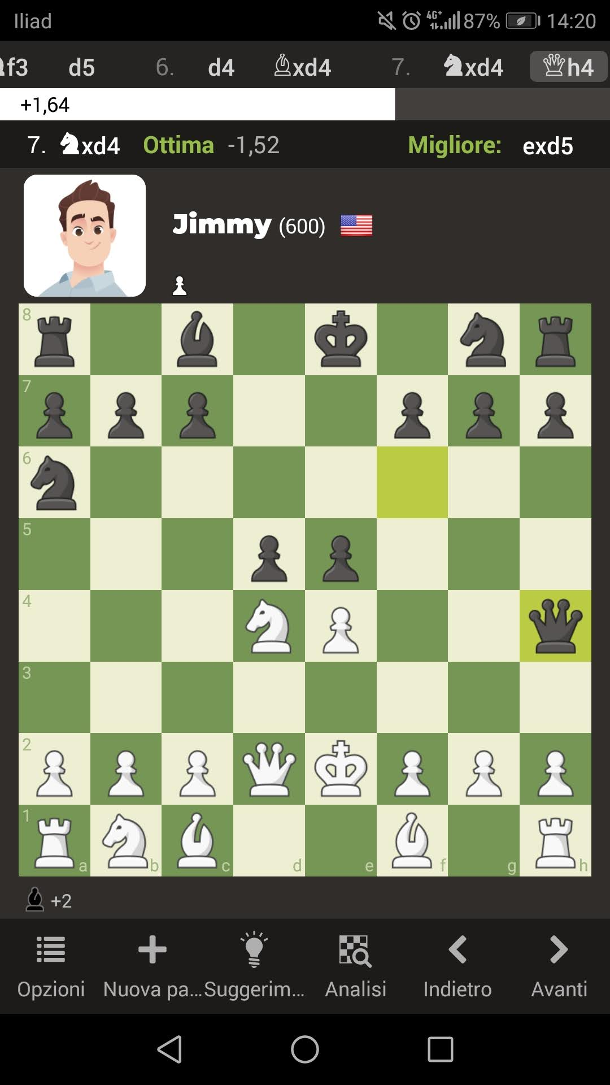
The screen problem
Application used.
Placement of the chessboard on the screen.
They have a significant impact on chessboard recognition, although with the addition of some functionality this is a solvable problem.

Slide 13
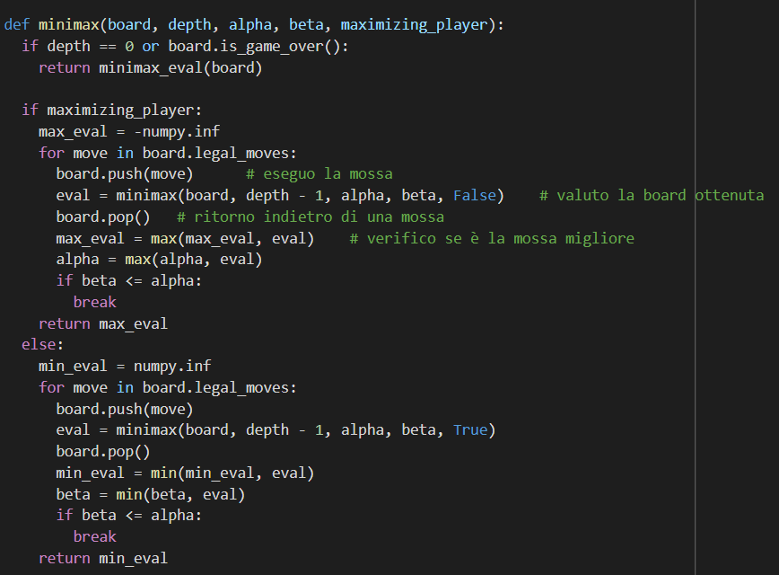
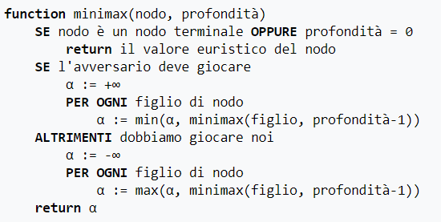
Minimax
Problem: execution time on mobile too long (up to 6 minutes).

Slide 14
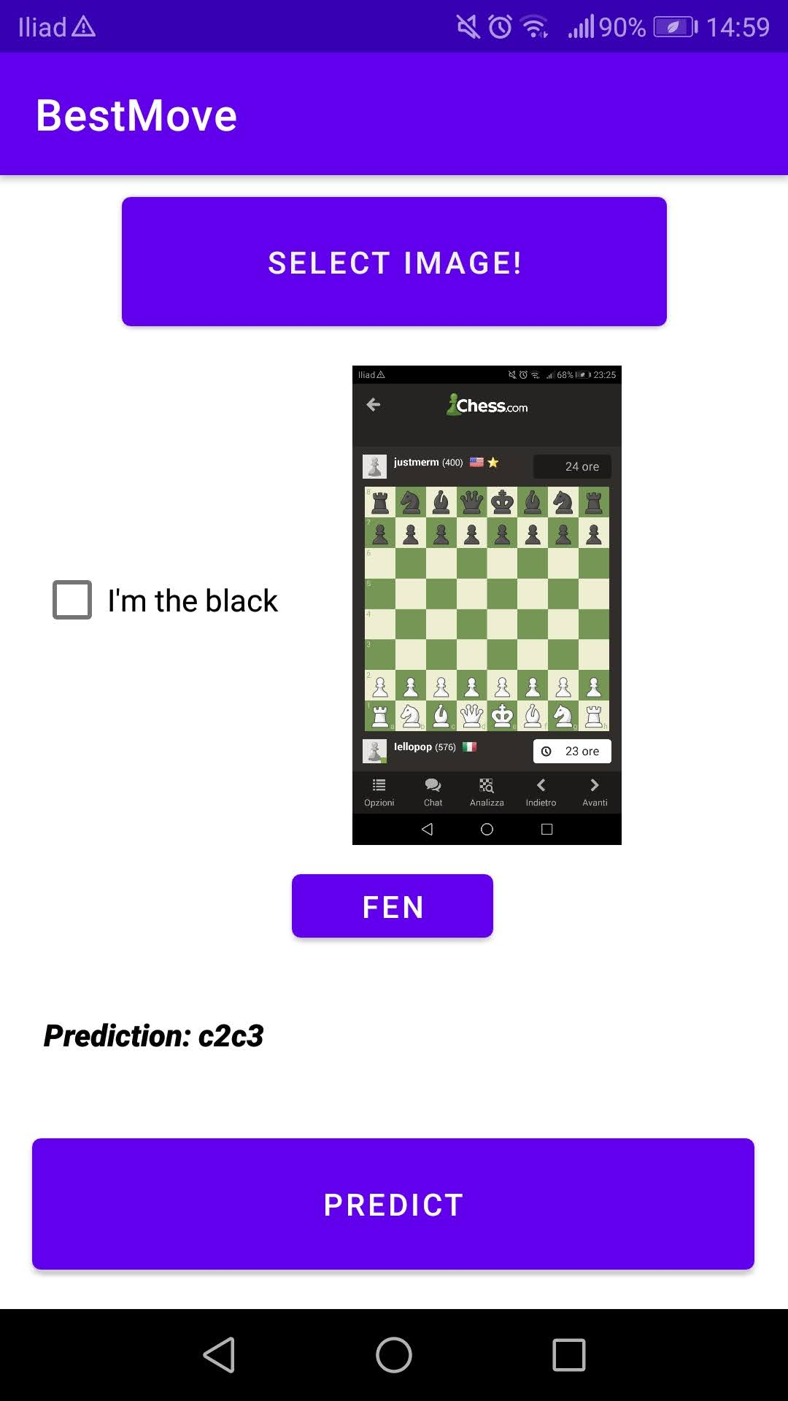
Conclusions
Next steps:
Portability.
Speed of execution.

